Slide 1
What’s New in C# 8.0
Content originated by Mads Torgersen
Supplemented by Scott Dockendorf

Slide 2


Agenda
C# 8 Availability
New Features
References

Slide 3

C# 8.0 Availability
Currently in Preview status with .net Core 3.0 (Preview 5)
Requires Visual Studio 2019
Async streams, indexers and ranges, and default interface member implementations require .NET Standard 2.1 platform dependency
Available on Xamarin, Unity & Mono (but NOT .net 4.8)
Download Visual Studio @
https://visualstudio.microsoft.com/downloads
Download SDK 3.0 @ https://dotnet.microsoft.com/download/dotnet-core/3.0
C#

Slide 4
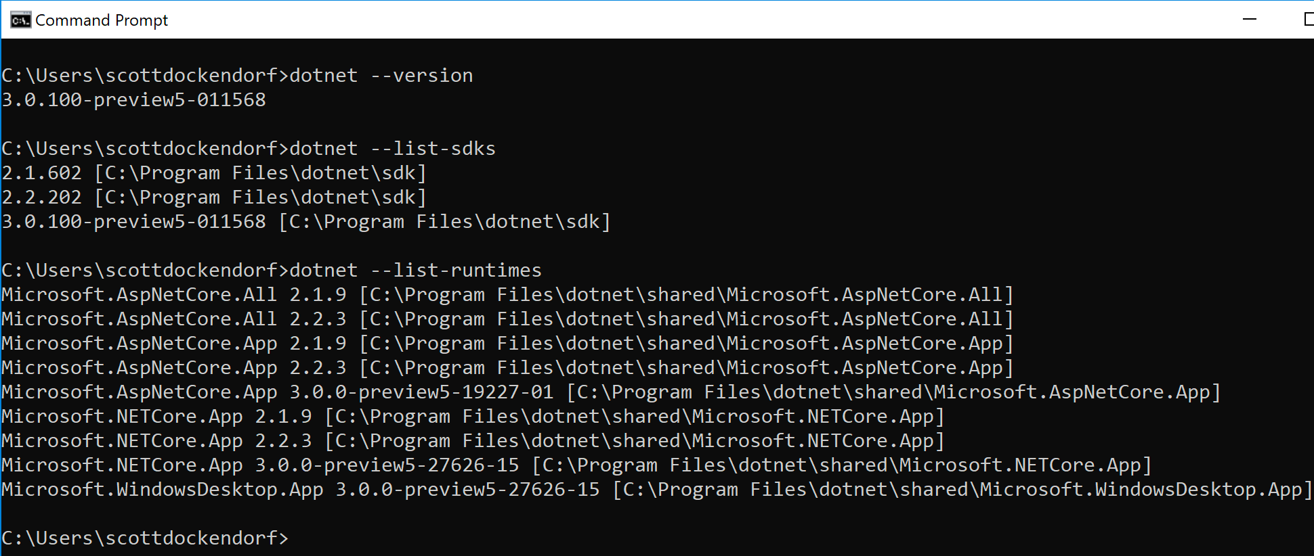
Installing .net Core 3.0
Download SDK 3.0
Run Installer
Open Command prompt
Confirm install
Enable in Visual Studio

Slide 5
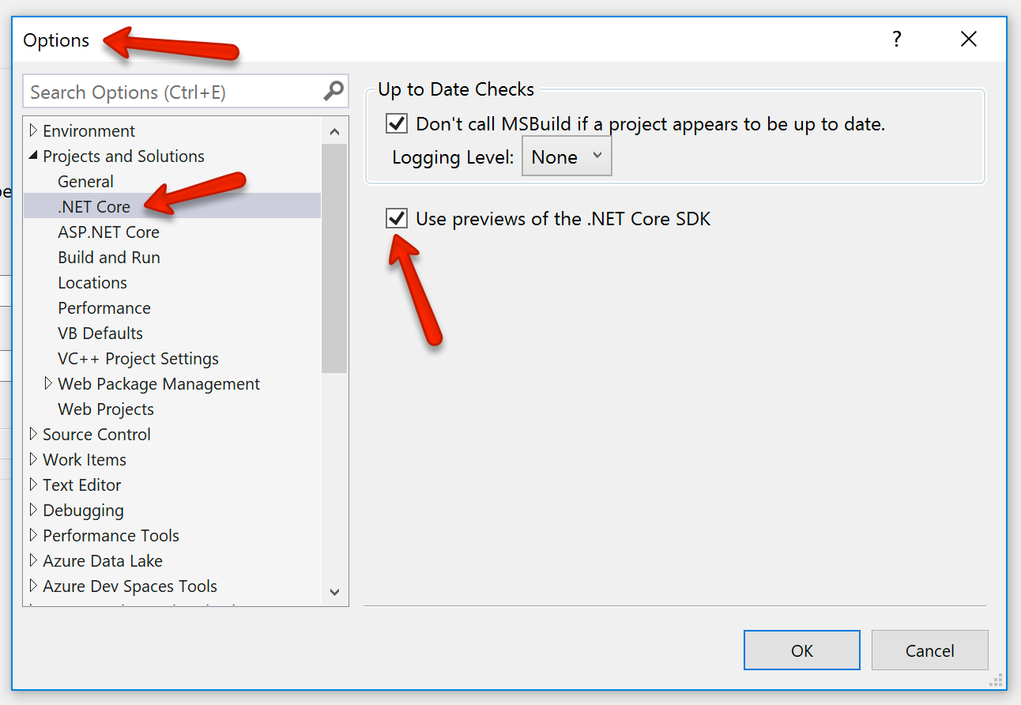
Installing .net Core 3.0
6. Enable .NET Core SDK Previews in Visual Studio
Tools -> Options ->
Projects and Solutions -> .NET Core
Select the “Use previews of the
.NET Core DSK”
Click OK to complete

Slide 6
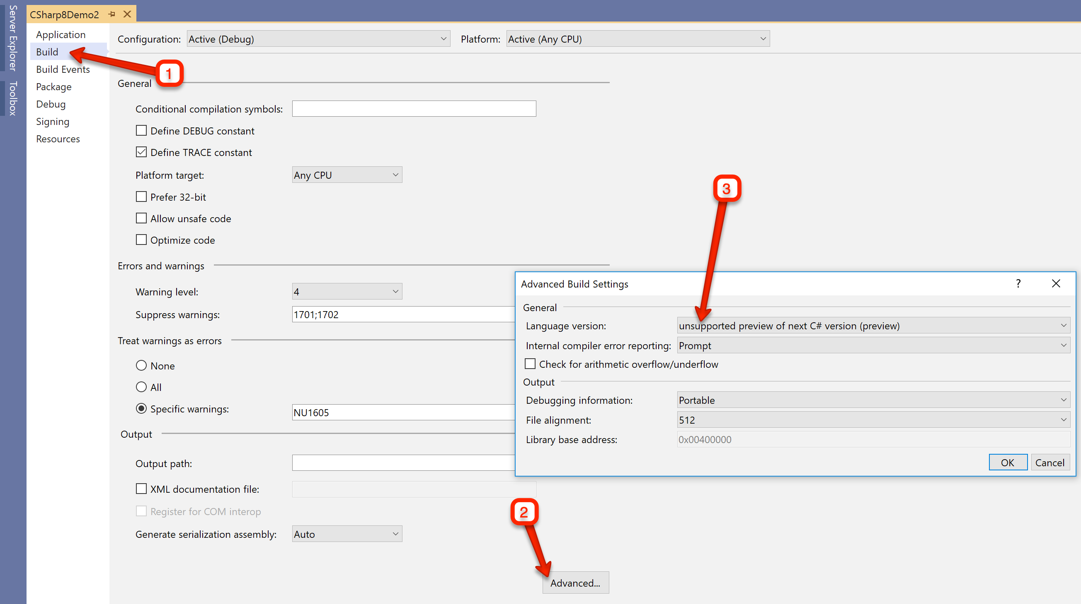
Installing .net Core 3.0
8. To enable new C# 8.0 language features, edit your project properties:
-> Build
-> Advanced
-> Language version

Slide 7


C# 8 New Features
Nullable reference types
Async streams
Switch Expressions
Ranges and indices
Default implementation of interface members
Recursive Patterns
Target-typed new expressions

Slide 8
DEMO: Nullable reference types Async streams Switch Expressions
Scott Dockendorf
Notes:
Simplified project template
In-process hosting
HTTP/2
API conventions

Slide 9
Returning a full name today
private static string GetFullNameOldWay(Person p)
{
var result = string.Empty;
if (p.FirstName != null && p.MiddleName != null && p.LastName != null)
{
result = $"{p.FirstName} {p.MiddleName[0]}. {p.LastName}";
}
else if (p.FirstName != null && string.IsNullOrEmpty(p.MiddleName) && p.LastName != null)
{
result = $"{p.FirstName} {p.LastName}";
} else if ( p.FirstName != null && string.IsNullOrEmpty(p.MiddleName) && string.IsNullOrEmpty(p.LastName ))
{
result = $"{p.FirstName}";
}
return result;
}

Slide 10
Returning a full name today – via Ternary operators
private static string GetFullNameALessWordy(Person p)
{
// this works...
return (p.MiddleName != null)
? $"{p.FirstName} {p.MiddleName[0]}. {p.LastName}"
: $"{p.FirstName} {p.LastName}";
// but what about other scenarios like
// FirstName only,
// LastName only,
// First & Middle without Last,
// etc..?
}
Notes:
Collapses if statements & Reduces branching

Slide 11
New 8.0 Feature: Recursive Patterns (w/Tuple Patterns)
private static string GetFullName(Person p)
{
switch (p.FirstName, p.MiddleName, p.LastName)
{
// Use tuple patterns to return desired value
case (string f, string m, string l):
return $"{f} {m[0]} {l}";
case (string f, null, string l):
return $"{f} {l}";
case (string f, string m, null):
return $"{f} {m}";
case (string f, null, null):
return $"{f}";
case (null, null, null):
return "Person";
default:
return "";
}
}

Slide 12
New 8.0 Feature: Switch Expressions
return (p.FirstName, p.MiddleName, p.LastName) switch
{
(string f, string m, string l) => $"{f} {m[0]} {l}",
(string f, null, string l) => $"{f} {l}",
(string f, string m, null) => $"{f} {m}",
(string f, null, null) => $"{f}",
(null, null, null) => "Person",
};

Slide 13
New 8.0 Syntax “Sugar”: Implicitedly-typed New Expressions
// NEW C# 8.0 FEATURE: SWITCH EXPRESSIONS
return (p.FirstName, p.MiddleName, p.LastName) switch
{
(string f, string m, string l) => $"{f} {m[0]} {l}",
(string f, null, string l) => $"{f} {l}",
(string f, string m, null) => $"{f} {m}",
(string f, null, null) => $"{f}",
(null, null, null) => "Person",
};

Slide 14




Get started with .NET Core & Visual Studio 2019 today!
Visual Studio 2019: https://visualstudio.com
.NET Core: https://dot.net

